Slide 1
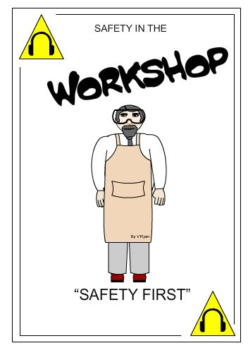
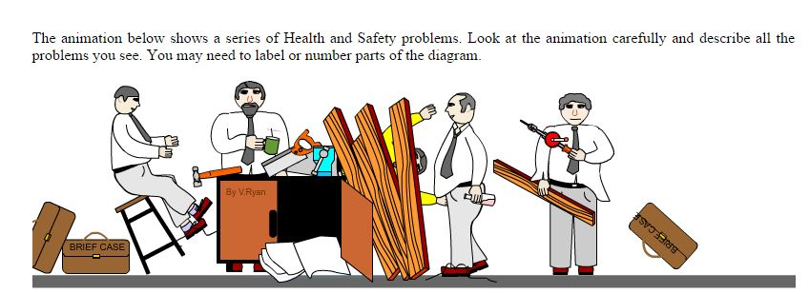
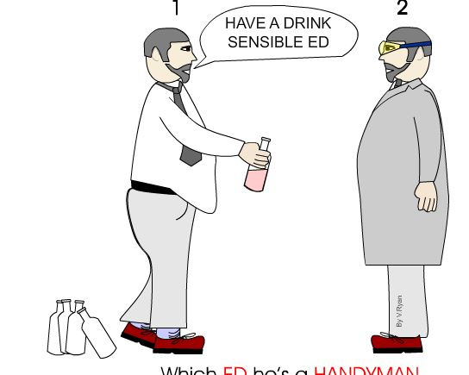
Safety First – Engineering and Technology
Marcus Barnwell Arabia Mountain High School
Introduction
Laboratory Safety is a very important aspect. Without it, experimentation could result in very serious injury, if not death, of course. To reduce the risks involved with experimentation, there are certain procedures that we should all follow as individuals and as a member of a group. It is important that the correct procedures are used in various situations, when handling hazardous or biological materials, when preparing, executing or cleaning up an experiment. It is also essential that you understand how to identify and use emergency equipment and protective gear.
Do’s
Yeas
These are things that are okay and safe to do in the lab.
• Always walk in the lab
• Wear approved safety glasses at all times.
• Tie up or contain long hair with an appropriate fastener.
• Report all accidents and injuries to the instructor immediately
• Operate machinery and power tools only with the instructor’s permission
Don’ts
No
This section shows all the things that you shouldn’t do while you are in the lab and how to keep you safe
The shop is no place for practical jokes or “horseplay”. This behavior is dangerous to you and to your classmates.
Working without a lab coat or wearing a lab coat outside of the lab
Working without safety goggles or glasses
Eating close to or directly at the lab bench
Conclusions
This lesson has taught me about all the safety procedures, and how to follow them. What to do in emergencies and to use all of my safety equipment to keep me safe.
Sources
https://en.wikibooks.org/wiki/Laboratory_Safety/Introduction
http://www.technologystudent.com/health1/ed1.htm
Safety.
Laboratory safety is a process and discipline, the goal of which is to prevent injuries and diseases from occurring among scientists, laboratory staff, non-laboratory staff and the community. 2.1.1 Laboratory Accidents. The fundamentals of lab safety are simple, and involve: teaching and performing science safely, watching out for yourself and everyone else in the lab, anticipating problems and preventing them, and being careful and aware of your surroundings
The bottom line is that it's vital to remember safety is a state of mind, and is about understanding risk, eliminating or minimizing hazards as much as possible, and being aware of the hazards that cannot be eliminated.
In the picture, all safe procedures are demonstrated. This is how you should perform while in the lab
In the picture above, things that are not safe are demonstrated. You should try hard not to perform any task like this
Ed on the left is not in the proper attire. The ed on the right is the the proper lab attire

